Slide 1
The Influences of Circular RNA Design Based on Computer Algorithms on the Future
Chenxi Ouyang, Chenjie xin, Haotian Wu, Chuanshi Xu

Slide 2
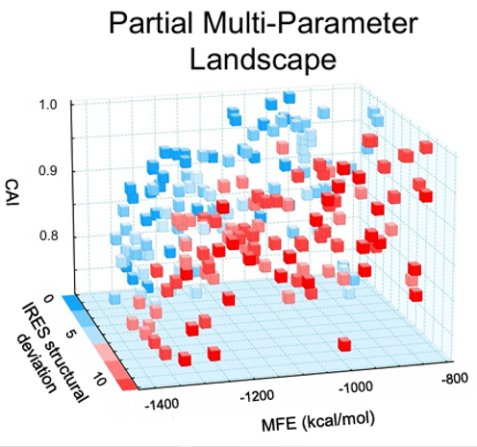
Introduction to circRNA and circdesign
CircRNAs have unique covalently closed-loop structures, which can enhanced stability, and prolonged protein expression compared to conventional linear mRNAs.
However , we still need to find a way out to achieve three critical objectives: preservation of highly efficient circularization, structural compactness of circRNA and full exploitation of IRES-mediated initiation capacity.
Circdesign can solve the problem of the rational design of a circRNA sequence to jointly improve its stability and protein coding potential.

Slide 3
Challenges and Limitations
focuses on a single coding sequence (CDS)
lack of chemically modified nucleotides
One of the major limitations is that mRNA expression is influenced by several factors, including tertiary structure, codon usage bias, untranslated regions , and cellular context(Mo et al., 2025). This means that optimizing only a single part, such as the coding sequence, is insufficient for maximizing translation efficiency. Additionally, current research is focused on CDS and IRES, without considering other special regions of mRNA that influence significantly to function and stability (Xu et al., 2025). It may reduce the stability and translation efficiency of mRNA due to the ignorance of some special codon.
Another critical limitation is not incorporation of modified nucleotides in current circRNA design strategies(Xu et al., 2025). Modified nucleotides such as pseudouridine or 5-methyleytidine have been shown to improve mRNA stability and translation. The ignorance of it will significantly restrict the full therapeutic and functional potential of circRNA application. If future designs can integrate modified nucleotides based on empirical evidence, the applications of circRNA in therapeutic protein expression and gene regulation could be significantly broadened.

Slide 4
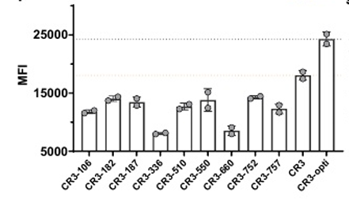
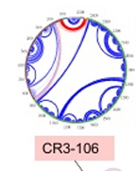
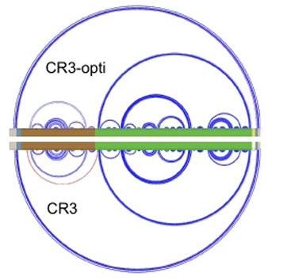
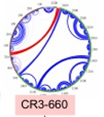
Conclusion
Proteinexpressionlevels
It can be clearly seen that the smaller the IRES structural deviation of RNA, the higher the expression level of protein.
The red line indicates that the bases of the IRES structure are connected to other regions, resulting in the destruction of the IRES structure. The blue lines indicate the normal base pairing within each structure.
IRES with the greatest structural deviation
IRES with the least structural deviation

Slide 5
Thank you!

